Slide 1
MPA-MLF • 2026
Final Project — MPA-MLF 2026
Room Occupancy
from 60 GHz Radar
A pure-CNN ensemble that classifies 0–3 persons
Rank #4
Kaggle public LB
Pierre Massy & Volkan Ozcoban
ISEP • Kaggle competition
Final score: 0.97565 (Top 1 = 0.97819)
Notes:
Opening (≈30 s)
Hello everyone, we are Pierre Massy and Volkan Ozcoban.
Today we present our final MPA-MLF project: classifying how many people — zero, one, two or three — are inside a room, only from a 60 GHz radar image.
The competition was run on Kaggle; out of the class we finished 4th, with a public leaderboard accuracy of 97.57 percent.
The slides will walk you through the problem, our preprocessing, the model we trained, and our final result.

Slide 2
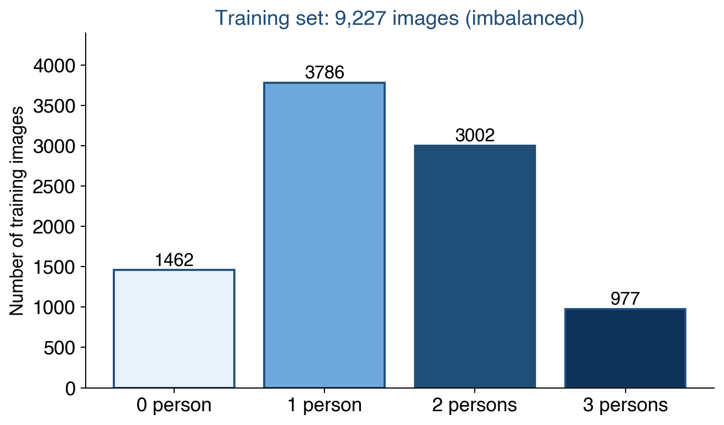
1 · The problem and the data
4-class image classification • metric = accuracy
Input
• A 60 GHz mmWave radar produces one
delay–Doppler image per 1-second sample.
• Colour-encoded image 45 × 51 pixels, RGB.
• Paded to 48 × 64 so CNN strides are clean.
Target
How many people are in the room?
→ classes 0, 1, 2 or 3.
No sequential info — each image is independent.
Dataset size
9 227 training images • 3 955 test images
Classes imbalanced → class 3 is the hardest.
Pierre Massy & Volkan Ozcoban • MPA-MLF 2026 • ISEP
2 / 5
Notes:
(≈1 min)
The data comes from a 60 GHz millimetre-wave radar.
For every one-second window, the radar emits chirps and returns a *delay–Doppler image*:
the vertical axis is distance, the horizontal axis is velocity,
and the colour intensity measures the reflected power.
Our job is to count how many people are in the room — 0, 1, 2 or 3.
It's a simple 4-class classification problem, evaluated with plain accuracy.
The training set has 9 227 images and we must predict 3 955 images.
The class distribution is unbalanced: 3 persons is under-represented,
so getting that class right is the key challenge.

Slide 3
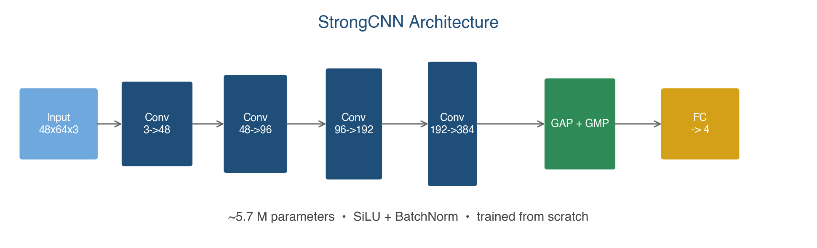
2 · Preprocessing and model
A simple CNN trained from scratch — no transfer learning
Preprocessing
Model
1
Load PNG as RGB uint8
2
Pad 45×51 → 48×64 (mirror)
3
Normalize to [0, 1]
4
Light augmentation:
random shift ±2 px, horizontal flip
Training recipe
AdamW • cosine LR • 50 epochs • mixup α = 0.1
batch 512 on Colab T4 (CUDA) — ~15 min per seed
Pierre Massy & Volkan Ozcoban • MPA-MLF 2026 • ISEP
3 / 5
Notes:
(≈1 min 15 s)
The preprocessing is deliberately minimal.
We load each radar PNG, pad the 45×51 image up to 48×64 so that four conv strides divide cleanly, then rescale to zero-one.
At training time we only apply two light augmentations: a random pixel shift and a horizontal flip.
For the model we did NOT use transfer learning — ImageNet weights make no sense on a 48×64 radar spectrogram.
We train a small custom CNN from scratch, the "StrongCNN":
four convolutional blocks going 3 → 48 → 96 → 192 → 384 channels,
SiLU activations, BatchNorm, and a head that concatenates global average and global max pooling, then projects to 4 logits.
Around 5.7 million parameters — small enough to train on Colab T4 in 15 minutes per seed.
We use AdamW with cosine learning-rate annealing, mixup alpha 0.1, and a batch size of 512.

Slide 4
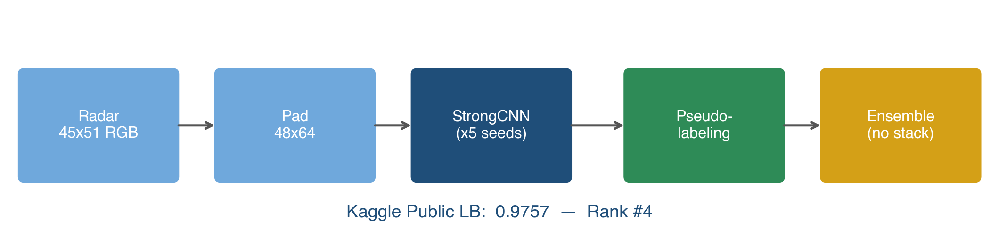
3 · What actually wins: ensemble + pseudo-labels
Simple averaging beat a fancy stacker
Multi-seed training
Pseudo-labeling
No-stack blending
Train the same CNN with 5 different random seeds.
Each seed learns slightly different errors — averaging them removes noise.
Predict the test set.
Keep the 2 291 test images where the blend is ≥ 99 % confident.
Retrain using those as extra ground truth.
Simply average the probabilities of our CNN models.
Tried a LogReg stacker on OOF probs → better CV, but
WORSE leaderboard. Dropped it.
Pierre Massy & Volkan Ozcoban • MPA-MLF 2026 • ISEP
4 / 5
Notes:
(≈1 min 30 s)
Training a single CNN only takes you to about 96 % accuracy.
To push further we combined three simple tricks shown on the pipeline at the top.
First, multi-seed training. We retrain the exact same architecture with 5 different random seeds.
Each seed ends up making slightly different mistakes, and averaging their probabilities removes some of that noise.
Second, pseudo-labeling. Once the 5-seed ensemble predicts the test set,
we keep the images where the averaged confidence is above 99 percent.
That gave us 2 291 extra "free" labels, which we fed back into a second round of training.
Third — and this is the key lesson of the project — we tried to stack the models using a logistic regression on the out-of-fold probabilities.
The stacker looked great in cross-validation, 97.07 percent OOF.
But when we actually submitted it, the leaderboard DROPPED by almost 0.7 percent.
So we went back to the simplest possible blend — just averaging probabilities — and that is what gave us the final result.

Slide 5
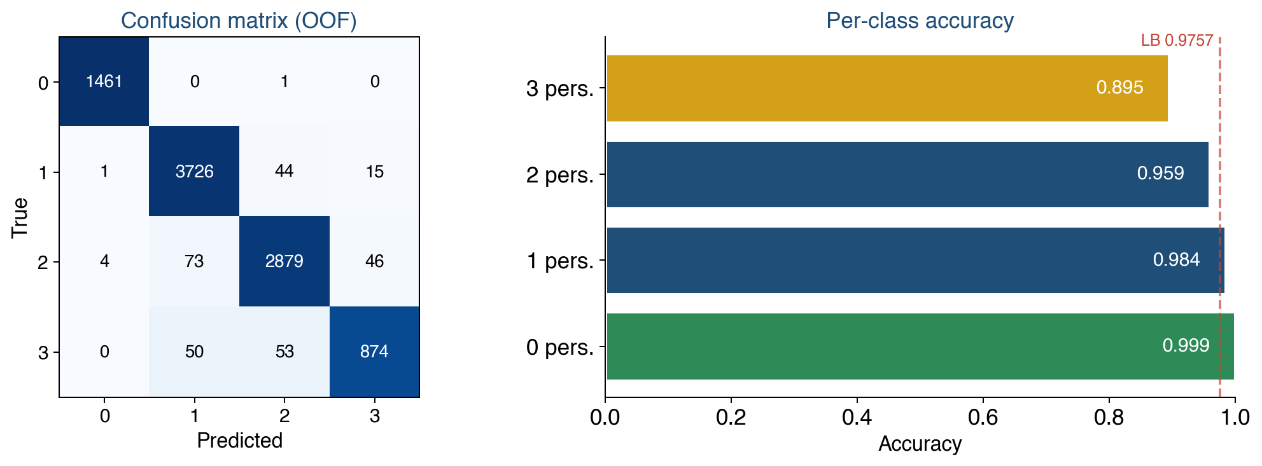
4 · Results
Final leaderboard • where the errors are
Final leaderboard
0.9757
accuracy • rank #4 / class
Leaderboard context
Top 1 in class
0.97819
Us (final)
0.97565
Full-fit + pseudo
0.97515
Stacker variant
0.96855
Features only (HGB)
0.9328
Take-home message
A small CNN from scratch + multi-seed average + pseudo-labels ⇒ within 0.3 % of the best team.
Pierre Massy & Volkan Ozcoban • MPA-MLF 2026 • ISEP
5 / 5
Notes:
(≈1 min 15 s)
Our final submission reached 97.57 percent accuracy on the Kaggle public leaderboard, which puts us in fourth place of the class.
For reference the top submission is at 97.82 percent, so we are less than 0.3 percentage points behind the winner.
Looking at the confusion matrix on the right, the classifier is almost perfect on the zero-person class.
The hardest class is "3 persons", which is both the least frequent in the training set and the one where people tend to occlude each other in the radar image.
The confusions are almost always between neighbouring classes — 1 vs 2, or 2 vs 3 — which is a reasonable failure mode.
The take-home message is on the bottom:
we did NOT need a transformer, transfer learning or a heavy pipeline.
A small CNN trained from scratch, averaged over 5 seeds and boosted with pseudo-labels, was enough to reach nearly the top of the class.
Thank you — we'd be happy to take your questions.

